Slide 1
Screening, Recruitment & Retention
Education Series
2024
Presenter: Michelle Smyth, CRN
Irish Research Nurse and Midwives Network
1
Notes:
Hi everybody
Would like to welcome you all to the IRNM Education Series for 2024.
My name is Michelle Smyth and I'm a clinical research nurse in critical care and anaethetics with the RCSI
this first presentation is on Screening recruitment and retention in clinical trials.
at the end of the presentation you will be invited to complete a short MCQ and once completed you will receive your certifcate of attendance.
on behalf of the irnm education working group, i would like to thank you for your participation.
1

Slide 2
Learning Outcomes
Appreciate the requirements for preparation, screening and recruitment
Identify essential documents to be in place prior to commencing a clinical trial
Critically review issues, processes and procedures for patient recruitment and retention
Irish Research Nurse and Midwives Network
2
Notes:
2

Slide 3
Background
Clinical trials essential for advancing medical knowledge and developing new treatments
Often face challenges related to screening, recruitment and retention of participants
Effective strategies are crucial
Recruitment and retention are two major bottlenecks in conducting clinical trials and contribute vastly to delays
Irish Research Nurse and Midwives Network
3
Notes:
in healthcare, clinical trials have been essential in advancing medical knowledge and also in the discovery and development of new treatment for patients
this was greatly evident during the covid 19 pandemic when healthcare workers were faced with a new disease and no potential treatment. through research and clinical trials we quickly discovered treatments that were beneficial to patients with covid 19 but also those that could potentially harm patients
However clinical trials often face challenges related to screening, recruitment and retention of participants.
Patient enrolment is cited as one of the most challenging aspects in the conduct of clinical trials and it is one of the primary reasons that a clinical trial fails. there for it is imperative that we have effective strategies to minimise and ensure clinical trials do not fail
recruitment and retention are two of the major bottlenecks reported in literature in conducting clinical trials and
not only contribute vastly to delays in achieving recruitment targets but can also impact on a study budget and end analysis
3

Slide 4
Study Set Up
Preparation is key
Important in site feasibility and protocol review if your site has right patient population
May be beneficial to set monthly site recruitment target
Once site activation received, time to start recruitment
Irish Research Nurse and Midwives Network
4
Notes:
Prior to commencing a study at your site Preparation is the key element in ensuring a study runs well and that you and the research team will succeed.
It is important before a site agrees to participate in a study that site feasibility has been undertaken to ensure your site is the right site to participate. During site feasibility it is important to identify if your site has access to the right population as required in the study inclusion, is able to provide diagnostic tests as required in the study protocol but that your site has the relevant experience to undertake the responsibilities in the study protocol.
For example, if you work in a teritary hospital in Ireland and you have been invited to participate in a clinical trial on traumas but your emergency department receives very little trauma or transfers traumas to the major trauma centres than that trial is more than likely not a trial for your site.
Once the research team has completed site feasibility and agreed participation with the study sponsor it may be beneficial for members of the research team to set a monthly site recruitment target. When it comes to setting site recruitment target it is important to be realistic with your target. You need to be realistic with what you can achieve and what you as a site and research team can deliver. You need to be mindful of the patient population, number of patients but also the number of staff on the research team
Once your site receives site activation or green light that is when it’s time to start recruitment and deliver on your recruitment target and not delay with commencing recruitment
4

Slide 5
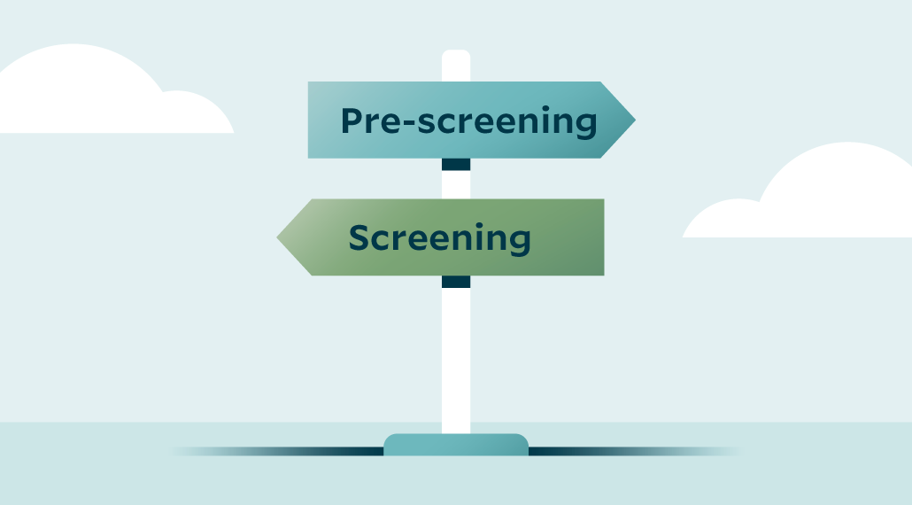
Screening
Screening involves the initial assessment of individuals to determine their eligibility for participation in a clinical trial
Ensures potential participants meet all inclusion criteria
Screening is a core foundation for success in trial enrolment
Pre screening Vs Screening
Distinction between two may seem trivial
Difference is critical from regulatory perspective
Important to know what procedures fall under which category
Irish Research Nurse and Midwives Network
5
Notes:
Before we look at recruiting participants we may need to undertake screening of potential participants.
Screening in clinical trials involves the initial assessment of individuals to determine their eligibility for participation
Screening is a core foundation for success in trial enrolment as it ensures we are targeting the right population for the right study.
When we look at screening we have two types of screening which we can undertake
Pre screening or screening
While the distinction between the two may seem trivial it is important that we are aware of the differences.
The differences are critical from a regulatory perspective but also from a GDPR perspective.
It is important as a research nurse when you are undertaking screening that you are away of the category the procedures you are completing falls in to.
5

Slide 6
Screening
Pre-Screening
Conducted prior to a patient giving consent to participate in a trial
Aims to gather information pertaining to patient’s eligibility
Based on study’s core inclusion criteria (e.g age, diagnosis) and exclusion criteria (co-morbidities, known organ dysfunction)
Cleared through pre-screening and confirms interest may proceed through screening
Irish Research Nurse and Midwives Network
6
Notes:
Pre screening is conducted prior to a patient giving consent to participate in a trial
as a research nurse, pre screening allows us to gather as much information as possible pertaining to patient eligibility. this is often a time to examine patient's medical charts and ensure that patient has no exclusion criteria such as chronic kidney disease or chronic heart failure, elevated BMI, or regular medication
pre screening allows the research nurse to identify core inclusion criteria such as demographic characteristics or clincial diagnosis
pre screening of patients may be completed weekly or monthly depending on your recruitment strategy and the number of clinical trials you have active at your site.
in my role as clinical research nurse in critical care i undertake pre screening daily due to number of clinical trials that are active in my units and also due to the high turn over of admissions to critical care. while i may pre screen 30 patients daily, there are some days no patients are eligible for any of the clinical trials or there may be days were 3 patients are eligible once I have completed pre screening
once a patient has been cleared through pre screening and the patient confirms their interest in participation they may then be invited to proceed through the screening visit.
6

Slide 7
Screening
Screening
Screening procedures cannot take place until consent is given
Compared to pre-screening, screening bigger investment
Deeper assessment of inclusion/exclusion criteria
Entails series of evaluations
Physical assessment, lab test, diagnostics
Baseline data collected can function as reference point
Without successful screening, patient cannot proceed to enrolment
Irish Research Nurse and Midwives Network
7
Notes:
when it comes to screening, screening procedures cannot take place until informed consent is ontained from the participant. when we compare pre screening and screening, screening visits are a bigger investment for the patient, study team and sponsor.
in some cases screening visits can last a number of hours and are a deeper assessment of the study inclusion and exclusion criteria
screening visits will entail a series of evaluations and assessment. these can be conducted by both the research nurse and or a medical doctor of the research team - principal investigator or co investigator. any medical doctor or research nurse who performs an assessment as part of the screening visit must be on the trial delegation log, have completed GCP training and undertaken training on the trial protocol.
it is important that when patients are attending for their screening visit they are aware of what the study visit will entail.
lab tests that will be undertaken as part of the screening visit may be sent to the study central labratory to be processed or in some cases may be processed at the hospital labratory
during the screening visits base line data that is collected can function as a reference point. for example for a study on asthma medication baseline pulmonary function tests can help determine if the the study medication is working.
if the patient fails their screening visit unfortunately they cannot proceed to enrolment and it is important participants are aware of this.
these patients should be recorded on your study screening log as a screened failure and the reason why for example elevated Liver function test or elevated kidney function.
7

Slide 8
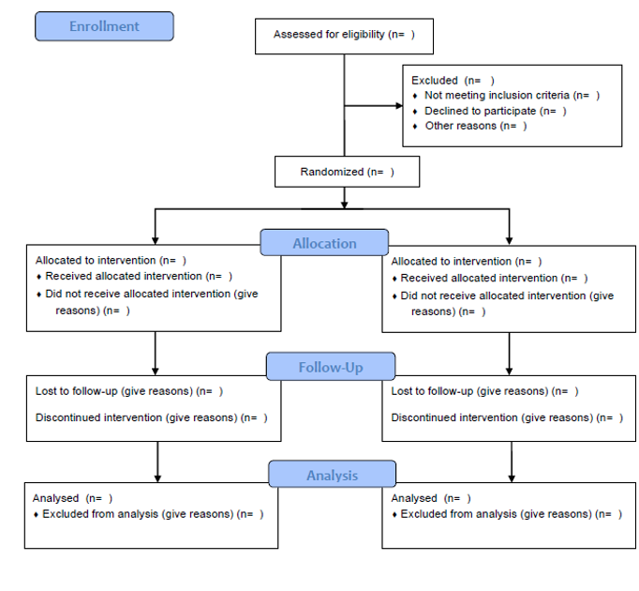
Screening Log
Important to understand flow of patients through study
Can help sites understand local issues
Information from screening logs may be used in final published results in form of CONSORT diagram
Screening logs are customised to needs of study
Screening logs are required to be completed and kept as part of study records
May be kept electronically or paper format
Irish Research Nurse and Midwives Network
8
Notes:
in your trial investigator site file you will receive a template of a screening log.
screening logs are an important document to the study sponsor to understand the flow of patients through the study at your sites.
often information recorded on screening logs may be used in the final published results in the form of a consort diagram.
a consort diagram will show the progress of participants through the phases of a trial of the assigned groups. for example the number of patients screened, the number enrolled, the number to intervention allocation, the number that completed follow-up, and final number in the data analysis)
For a site screening logs can be helpful to understand any local issues in relation to difficulty recruiting patients
for example if a study was being undertaken on stroke patients and patient were to be recruited within 4 hours of onset of symptoms. if the site was consistently missing recruitment of these patients, the research team may have to reconsider how they are notified of these potential patients.
Screening logs are customised to needs of study. These will include basic information on participant, reason for not recruiting – fully met inclusion criteria, no exclusion but patient refused or fully met inclusion criteria but had an exclusion criteria
screening logs will be required to be kept as part of study records and it is dependent on the site and study if these are kept in paper format or electronically on the trial database.
if they are kept in paper format these will be required to be sent to study sponsor with redacted identifable information at the end of the study or if they are kept electronically they may be required to be printed out at intervals throughout the study or at the end of the study and filed in the site file.
8

Slide 9
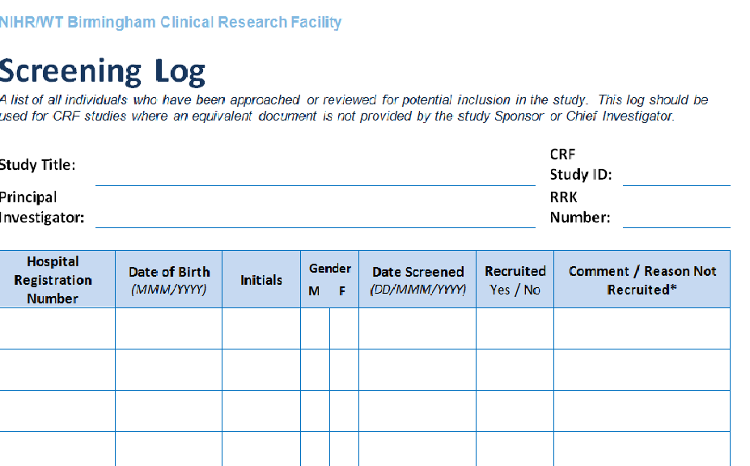
Screening Log
ABCD Study
1234
Unique Study Identifier
Short / Long title
Dr Jones
1234
Irish Research Nurse and Midwives Network
9
Notes:
this is an example of a study screening log. as part of the screening log you will be required to complete the title of the study this can be the long title or short title of the study
you will record the name of the principal investigator and unique site id number as assigned by the sponsor.
hopsital registration number - it is important to be consisten in what you select as hospital registration number. for some hospitals if the patients has a number of indentifying numbers ie medical record number, histor number or episode number as a research team decide which will be your hospital identifier on trial documents
date of birth month and year is sufficient
initials gender self explanatory
date screened - this is the date screening visit was completed. important to follow the format on the template.
record if the patient is recruited. yes no
if the patient is recruited you can document the study id as a comment or in the event the patient is not recruited you can record the reason why or the exclusion criteria
for some screening logs the exclusion criteria will be listed at the bottom or back of the form and you can record the corresponding number
at the end of the study, the sponsor may also request for the PI to sign off on the completed study screening log
9

Slide 10
Tips for successful screening
Inclusion and exclusion criteria
Review medical records in depth
Engage all team members to ensure familiarity with the study
Physical availability and direct communication between staff and research team
Establish effective communication with physicians and nursing staff who may refer potential patient
Eligibility criteria readily available
Irish Research Nurse and Midwives Network
10
Notes:
when it comes to achieving successful screening there are a number tips to ensure we suceed
as a research nurse it is important to be aware of the inclusion and exclusion criteria. if you have a number of studies it can be helpful to print the inclusion/exclusion criteria from the study protocol or the study synopsis and have it handy by your desk when you are pre screening.
review medical charts in depth and be aware if patients have multiple volumes of medical chats. depending on when volumes commenced you may need to request additional volumes from medical records to ensure medical records are adequately reviewed
it's important to engage regularly with members of the medikcal and research team and ensure open and regular communications between these.
for example if you are recruiting a study which recruits patients from the emergency department a daily check in or hello to staff can help. delivering education regularly to departments or units were your potential participants are being referred from can also help inform staff members and help with the referral of patients.
for studies were multiple teams can refer patients, a whats app group may be helpful with the team members and research nurse or study PI, if you set up a whats app group, please be mindful of GDPR!
identifying nurse champions is a great way to involve nursing staff in identifying potential patients
and having eligibility criteria readily available to staff for example lanyard cards with simple inclusion criteria is easy way to remind staff or if teams have whats app groups sending in a picture of the inclusion criteria once a month/fortnightly can help
10

Slide 11
Recruitment
Recruitment is often cited as a significant challenge in research
Recruitment of planned sample size within defined time frame
Insufficient or untimely patient recruitment can have serious consequences
Length of trial may need to be extended
Increase resource use
Increase costs
Compromise quality and reliability of study results
Recruitment for successful clinical research
Irish Research Nurse and Midwives Network
11
Notes:
Patient enrollment is cited as one of the most challenging aspects of clinical trials and it is one of the primary reasons that a clinical trial fails. These costly and time-consuming delays are found in all phases of clinical research and present themselves differently in each phase.
the recruitment of the planned sample size will always be determined by the study protocol and is known at the start of the study. sometimes sample sizes may need to be increased after interim analysis.
insufficient or untimely patient recruitment can have serious consequences on clinical trials. one of these consequences is
length of trial may need to be extended - this was evident during COVID 19 when patiexnts were unable to be recruited in the traditional manner due to clinics moving to tele medicine and and when the focus of research turned to trials in covid 19
recruitment is imperative for success in clinical reserach
11

Slide 12
Recruitment Windows
Recruitment window based on first patient/first visit to last patient/last visit
Recruitment is becoming more competitive
As a site want to reach target recruitment
Irish Research Nurse and Midwives Network
12
Notes:
Each study will have a recruitment window, based on projected timelines from first patient/first visit to last patient/last visit.
Recruitment in clinical trials is becoming more and more competitive, You may have a protected recruitment period at the start of a study) and if you haven’t achieved your recruitment target by a set time, other site may be allocated or have access to your planned recruitment numbers. Once the study reaches its overall recruitment targets recruitment closes.
You will want to reach your target to make doing the trial worth your while and to encourage the sponsor to come back to you with new trials. While recruitment numbers are not the only factor in deciding to place a study at a site it is certainly one of the major decision makers for Sponsors. However, you need to balance enthusiastic recruitment with ethical patient care.
it is important to ask yourself Are your recruitment strategies ethical / appropriate? At all times during the recruitment phase you need to consider the rights, safety and wellbeing of the patient. Look at their individual circumstance, is this trial tright for them at this given time. The recruitment phase is a key time for the clinical research nurse midwife to act as an advocate for patients.
Maybe on paper a patient meets the inc /exc criteria, but in practice it may be too demanding, they may not fully comprehend what it involves, they may be vulnerable for other reasons. Take time to consider each patient properly.
12

Slide 13
Recruitment Methods
Study Recruitment
Disease registries
Database trawl
Chart review
Adverts
Specialist services
Website and social media
Charity and patient groups
Referral letters
Nurse specialist
Irish Research Nurse and Midwives Network
13
Notes:
there are many methods for recruitment in clinical trials
Most of these recruitment methods are particularly suitable for more chronic stable disease groups:
Database trawl – if investigator has access to a specific disease database, it may be appropriate to use it to identify potential patients.
Chart review – can occur at the patient source i.e. OPD, ED, ICU. it May be useful to provide an abbreviated list of main inc/exl criteria to prompt the Investigators team, or others involved in recruitment.
Specialist nurses – are an excellent resource for recruitment, they will be very familiar with their patients and can help decide who would be suitable.
for patients who Self Refer for participation they may be responding to an advertisement about the study. You should use a list of key inc/exc questions to establish preliminary suitability when they first make contact to enquire about the study.
New Referrals to specialist teams can help, especially if looking for patients who have not yet been treated for a particular condition. When patients are being seen outside of the clinical setting it is not inappropriate to fast-track them from a waiting list.
GP referral can be helpful for common diseases such as asthma or diabetes–it may be useful to establish a system with GP whereby he/she refers suitable patients directly for a study– this fast track for patient into a study will not impact on others on a waiting list.
Patient organisation / Charities – may wish to post information on their website / newsletter to inform members of potential studies
For more acute studies, you may need to be in regular contact with specialist units, regarding admissions / new potential patients.
13

Slide 14
Challenges to recruitment
Stringent inclusion/exclusion criteria
Treating clinician does not have equipoise
Unavailability of research staff to recruit within randomisation window
Vulnerable patients
Substitute decision maker do not feel comfortable/wish to be responsible for signing informed consent
Fear of receiving placebo
Fear of being treated like ‘guinea pig’
Staffing issues
Irish Research Nurse and Midwives Network
14
Notes:
recruitment and achieivng site target can be a challenge for the research team
often these challenges are outside of their control
some challenges which may be faced could be due to too
stringent inluscion and exclusion criteria which can pose a chanllenge for the research team. while you may have access to the right patient population it may be a diangostic test such as a biomarker sample performed during screening visit that is the main reason patients at your site are failing screening visits or
maybe it could patients disease has progressed between initial prescreening and review at screening visit
another challenge may be a treating clinician does not have equipoise in the study intervention
unavailability of research staff to recruit within randomisation window is another challenge faced for those recruiting patients in clinical trials for patients in emergency or critical care setting
for the vulnerable patient group for example in critical care next of kin during consent discussion may not feel comfortable to enrol their relative in a clinical trial as they may not be aware of their loved ones views on clinical trial participation
for some patients the fear of receiving placebo can be too great a risk to take
if a patient has a fear of being treated like a guinea pig or experiment. it is important during the informed consent prodedure we alleviate any of these fears and give patients the opportunity to ask questions and give them time to discuss the study with other health care workers such as a GP or specialist nurse
and staffing issues can be a challenge to recruitment.
14

Slide 15
Tips for successful recruitment
Conduct feasibility
Advertising and information material
Clear and easy to understand
Easily identifiable ‘value’ of research project
Professional and competent appearance
Clear and easy to remember contact details
Online presence
Easy to remember domain name
Eligibility criteria presented clearly
Create positive awareness online
Re-evaluate inclusion and exclusion criteria
Increase budget for recruitment activities
Irish Research Nurse and Midwives Network
15
Notes:
there are a number of ways we can ensure successful recruitment at sites
conduct feasibility to ensure you have the right patient population, right expertiese and you can undertake any required tests as part of the study protocol
Advertising and promotiional material for clinical trials should be clear and easy to understand. it may be worth discussing advertising material content with a PPI group for feedback. a reminder that any advertising material that is patient facing should be submitted as part of the ethics application and approved before use
if your study has an online presence it should be easily accessible to the public. the short title of the study can be a useful domain name. social media can be useful to create positive awareness online of your study. at the end of the study it is also a useful way to disseminate results
if your site is having issues with recruitment due to the inclusion exclusion criteria is may be beneficial to discuss this issue with the study sponsor. it may be a case that one exclusion criteria is too stringent in the study and a lot of potential patients are being excluded.
15

Slide 16
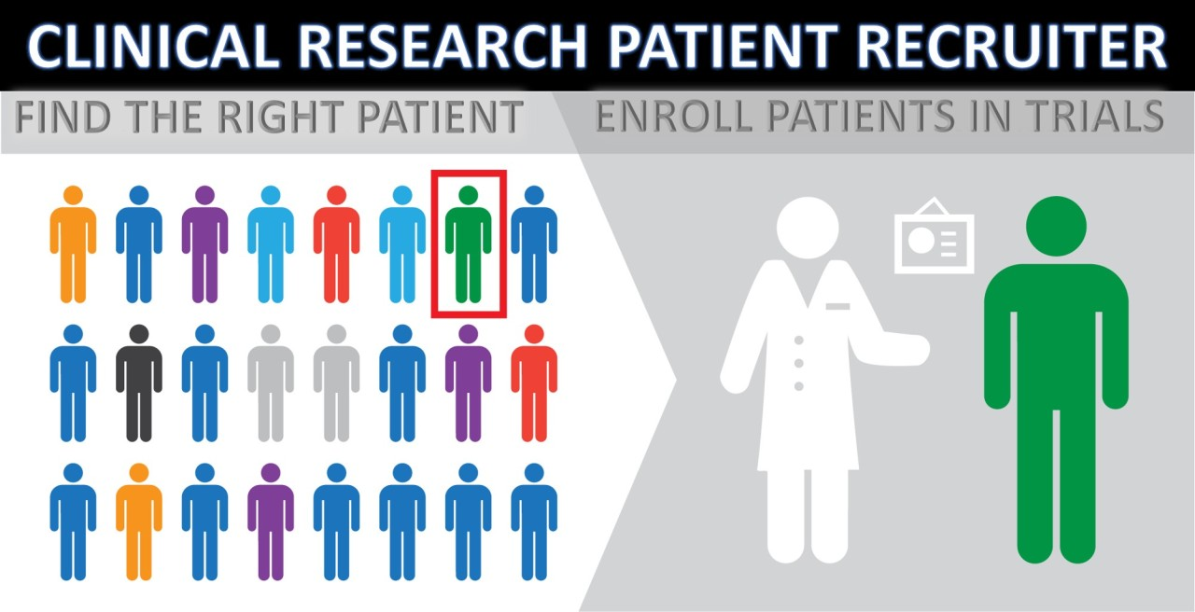
Tips for successful recruitment
Hold regular update meetings with investigators
Opportunity to discuss predicted and actual recruitment target
Allows issues to be resolved
Motivate investigators by frequent communication
Incentivise participation by medics
Irish Research Nurse and Midwives Network
16
Notes:
regular updates with the study prinicipal investigator and research team allows for any issues to be resolved around site recruitment and it also gives the study team an opportunity to discuss recruitment.
at these regular meetings going through screening logs may help any issues which can be solved locally
for medics and nursing staff who help identify potential patients, frequent communication via email, newsletter can help motivate investigators. reporting monthly or weekly recruitment of patients can also be a good way to keep up the motivation.
incentivise participation by medics who assist and identify patients for recruitment. while it may be difficult due to authorship for a medic to be listed as an author on a paper, if possible a medic who contributes greatly to overall site recruitment may be listed in the acknowledgment section of the paper
another way to incentivise participation by a medic or a nurse is recognising those who assist in recruiting 5 or 10 patients by a small token of appreciation
16

Slide 17
Retention
Apart from recruitment of participants retention is equally important
Participant is the most important member of the research study team
Multiple factors can influence a participant’s decision to drop out of a study
Some drop out inevitable and outside research team control
Many can be prevented
High levels of dropout can cause significant expense
Irish Research Nurse and Midwives Network
17
Notes:
apart from recruitment retention is equally important in clinical trials. as a research team we put a lot of effort in to recruitment there for it is important to retain our participants.
in clinical trials participants are the most important member of the research study team. and it is important we work with them to ensure their expereince in the trial is enjoyable and has minimal impact on their day to day activities.
there are multiple factors that can influence a participants deciison to drop out of a study and often these decisions are outside of the research team control. Participant drop out is also inevitable.
however as a research team we can work to retain our patients recruited.
in clincial trials high levels of dropouts can cause significant expense.
17

Slide 18
Challenges of retention
Experiencing side effects of study medication
Lack of improvement in the disease
Complexity of study protocol/burden on patient
Miscommunication or poor understanding of trial
Trial treatment method is not the participant’s preferred method
Irish Research Nurse and Midwives Network
18
Notes:
some of the challenges around retention can be minimsed through the course of the study.
for patients experiencing side effects of study medication it is important that patients are made aware of these potenial side effects and if the study protocol allows medications to be administered to counteract any side effects.
for some patients a lack of improvement in their disease can be a reason for deciidng to withdraw themselves from the study
burden on patients and complexity of study protocol can be a major influence in a patients decision to continue study participaiton. if possible allow flexibilitly in the time patients attend for appointments to minimise the impact on their work schedule, schedule study visits potentially on the same day as out patient appointments.
it may be beneficial during the initial conversation with participants providing a synopsis of schedule activities and time lines of study visits so they are aware of their committment
in some cases on reveal of study allocation, participants may decide to withdraw themselves from study participation as the trial treatment is not preferred treatment.
18

Slide 19
Tips to ensure retention
Minimise burdens during protocol design
Explain importance of participation
Promptly respond to inquiries
Send reminders for study visits
Provide schedule of visits at screening
Accommodate their schedule as much as possible
Provide a comfortable and friendly environment
Show appreciation and recognition
Follow up ‘thank you’ letter on completion
Irish Research Nurse and Midwives Network
19
Notes:
there are many ways a sponsor and site can ensure study participants recruited are retained
for sponsors minimising burdens on participants during protocol design can help with retention
for example length of time of study visits, number of study visits during the patients involvement in the clinical trial and number of interventions to be undertaken as part of a study visit.
as a clinical research nurse midwife developing a rapport with study participants is vital and can help with retention. depending on the legnth of the study you may be involved with patients for 3 months or even up to a year.
communication is key and ensuring patients can contact study team if they have any trial related queries and prompt responses can help alleviate any worries.
sending reminders via email or text message can help with retention of study participants. it's important to develop a communication strategy for the study that works for you as a research nurse/midwife and your patient
at the end of the study a simple thank you and recognising the participants contribution can help.
19

Slide 20
Participant Withdrawal
Participant withdrawal inevitable
Participant can withdraw at any time, without providing a reasons
Discuss if possible, reason why participant is withdrawing
Important to discuss with participant data that has been collected
Withdrawal of participant may be necessary by the Principal Investigator/study team
Non compliance with study protocol
No longer eligible
Irish Research Nurse and Midwives Network
20
Notes:
despite implementing all tips and tricks participant withdrawal is inevitable
a participant can decide to withdraw at any time through out the life cycle of a study without providing a reason
when patients are making the decision to withdraw if it is possible it may be benefical to ask participants the reason why they are withdrawing.
the reason provided could be something that can be avoided with other participants who are recruited.
during withdrawal it is important to discuss participant data that has already been collected.
participants may allow for the data collected up to the point of withdrawal to be used or they may decide to withdraw all data collected. it is important to document this decision in the pariticpants medical chart.
any biological samples that have been obtained and stored and your site should be disposed of securely and any identifiers removed. any paper case report forms should also be removed and destroyed via secure shredding
in some circumstances the withdrawal of the participant may be necessary by the PI. they may need to be withdrawn due to non compliance with study protocol or they may no longer be eligble.
when a patient has been withdrawn by choice or by PI it is important to notifiy the sponsor so any steps can be taken to remove patient data from the trial database.
20

Slide 21
Oversight and Monitoring
Sponsor responsibility to ensure recruitment on target
Sponsor will review site and study recruitment at regular intervals
Recruitment strategies may be used if study recruitment is below predicted
If recruitment strategies have not been included in Ethics application, a study amendment will be required
Sponsor will work with site to identify barriers to recruitment
Irish Research Nurse and Midwives Network
21
Notes:
over all it is the responsibility of trial sponsor to ensure recruitment is on tareget for the clinical trial
at regular intervals throughout the life cycle of the trial the sponsor will review site and study recruitment.
if sponsor feels study recruitment is below predicted they may utilise strategies to improve recruitment.
it is important to note, that in certain cases an amendment may be required to Ethics to include a recruitment strategy
as always the sponsor will work with the site team to overcome and identify any barriers to recruitment.
21

Slide 22
Conclusion
Enhancing screening, recruitment and retention in clinical trials requires a multifaceted approach
High levels of dropout can cause additional expense to sponsor
Can face various challenges and can require innovative strategies
By implementing efficient screening protocols, targeted recruitment efforts, participant-centered retention techniques, and technological innovations, researchers can optimize trial enrolment, engagement, and data integrity
Irish Research Nurse and Midwives Network
22
Notes:
to conclude
screening recruitment and retention of participants to clinical trials is a multifaceted approach
it is responsibilitiy of all involved - sponsor Pi and research team to ensure recruitment targets are met
High level of drop out can cause additional expense to sponsor
and can have an impact on the end results
\
by implementing efficient screening and recruitment efforts researchers can optimise trial enrolment and engagement of clinical trial participants
22

Slide 23
Thank You
michellecsmyth@rcsi.ie
Irish Research Nurse and Midwives Network
23
Notes:
on behlaf of the irnm education working group i would like to thank you for your time and participation
you will now be invited to complete an mcq to receive your certificate of attendance
23

